Slide 1
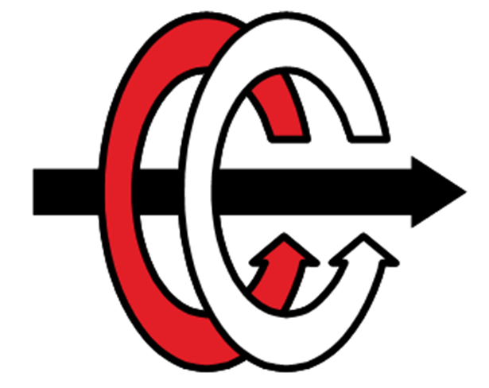

EE 564 Design of Electrical Machines
Fault-tolerant electric machines
Mustafa ÇELİKKAYA

Slide 2
Outline
Definitions
History
Application Areas
Fault Types
Fault Type Approaches
Geometry
Winding
Motor Drive System Failures and Solutions
Thermal Protection
Conclusion
References

Slide 3
What is Fault-Tolerant ?
The machine needs to maintain the same or comparable performance under fault to that when the machine was healthy.
In case of fault, the machine needs to fail safe without any catastrophic damage. (for safety-critical applications)

Slide 4
A safety critical system is the system whose failure may cause injury or death, which should have the ability to respond to an unexpected hardware or software failure.
A system is reliable when it is capable of operating without material error, fault or failure during a specified period in a specified environment.
A system is dependable if it is available, reliable, safe and secure.

Slide 5
History
Emerged for the first time in Information Technology.
The necessity of operating a system in degraded mode under the presence of almost any fault.
First Fault Tolerant Drives in early 1990s.
Jahns, T.M., No.3, May 1980
Salmon J.C. and Williams B.W., January/February 1980
Jack A.G, Mecrow B.C., AND Haylock J.A., 1995
Mecrow B.C., Jack A.G., Haylock J.A., and Coles J, 1996

Slide 6
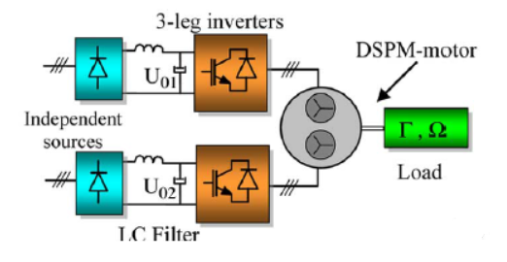
Application Areas
Aerospace
Military Applications
Medical
Nuclear Power Plants
Transportation
Electric Vehicle Propulsion
The Wind Power Generation

Slide 7
Fault Types
Electrical
Magnetic
Physical Separation of various phases
Thermal

Slide 8
Fault Types in The Drive
Winding open-circuit
Winding short-circuit (partial turn to turn or complete)
Inverter switch open-circuit (similar to winding terminal open-circuit)
Inverter switch short-circuit (analogous to winding terminal short-circuit)
Power device failure (either open or short-circuit)
DC bus open or short-circuit
Controller failure
Mechanical bearing failure
Insulation failure

Slide 9
Fault Tolerant Approaches
Main idea is;

Slide 10
Fault Tolerant Approaches
Main idea is;
« Substitute the faulted phase’s contribution by the healthy remaining ones »

Slide 11
Fault Tolerant Approaches
Geometry Approach

Slide 12
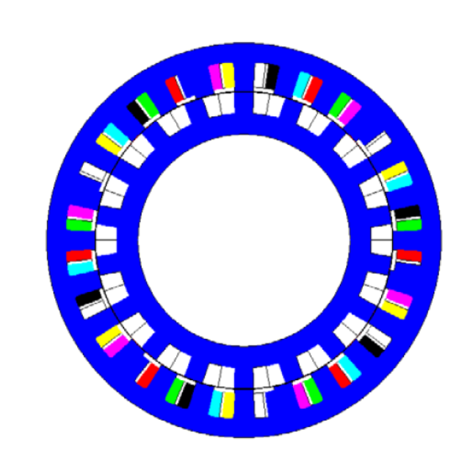
Geometry Approach
For multi-phase machines, increasing the number of teeth
A fault tolerant switched reluctance machine

Slide 13
Geometry Approach
For multi-phase machines, increasing the number of teeth
Lower torque ripple in case of different faults
A fault tolerant switched reluctance machine

Slide 14
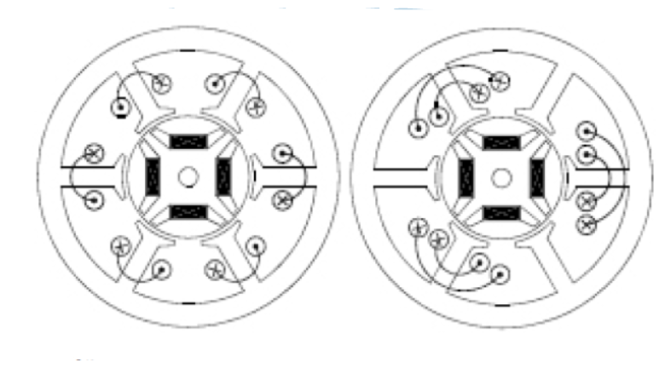
Geometry Approach
With a lower number of teeth
The fault tolerant synchronous permanent magnet machine

Slide 15
Geometry Approach
With a lower number of teeth
Simple magnetic circuit
More Complex Winding
High Number of Phase
Complex Winding Plan
Complicated Drive Unit !!!
MMF Harmonics are Consistent
which causes;
Unbalanced Saturation
Unbearable Torque Ripple
The fault tolerant synchronous permanent magnet machine

Slide 16
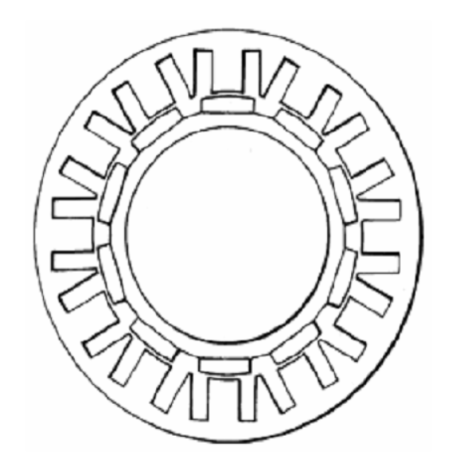
Geometry Approach
Armature coils are placed in pairs of slots
The walls of the slots are parallel to
Themselves
The wall of the other slot of the same slot pair

Slide 17
Geometry Approach
Armature coils are placed in pairs of slots
The walls of the slots are parallel to
Themselves
The wall of the other slot of the same slot pair
Spacer Tooth exists
Narrower than main teeth
Greater magnetic flux linkage between them
Thus;
increasing EMF within the coil.

Slide 18
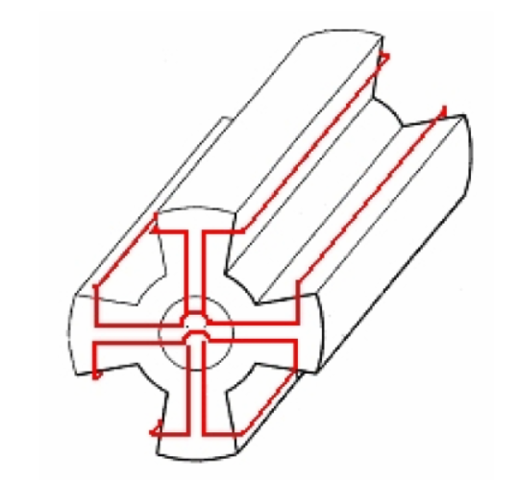
Geometry Approach
What if the rotor is passive ??
Previous solution is not applicable !
The solution is ;

Slide 19
Geometry Approach
What if the rotor is passive ??
Previous solution is not applicable !
The solution is ;
make the rotor active by placing a winding
in closed loop around each rotor pole
Similar to a MAGNET
the rotor will generate the force needed for passing over a pole having damaged winding

Slide 20
Winding Approach
By changing the winding arrangement
There are two solutions
Independency between the phase
Dubling the stator poles

Slide 21
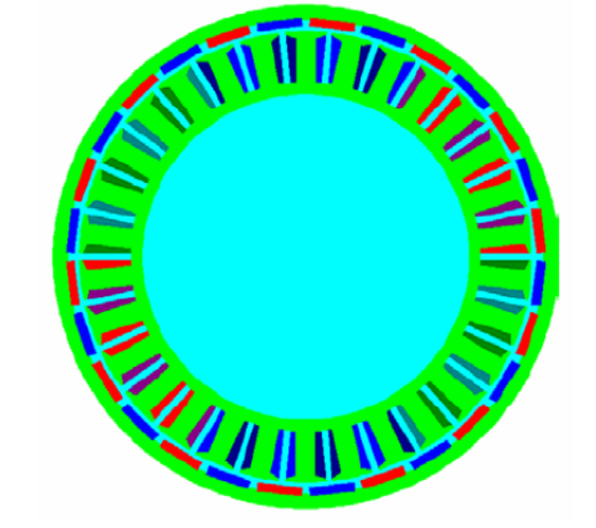
Winding Approach
independency between the phase windings
in order to reduce the effects of winding damages
high number of coils & a high number of phases
Higher Torque Density
Small Torque Ripple
Complex Drive

Slide 22
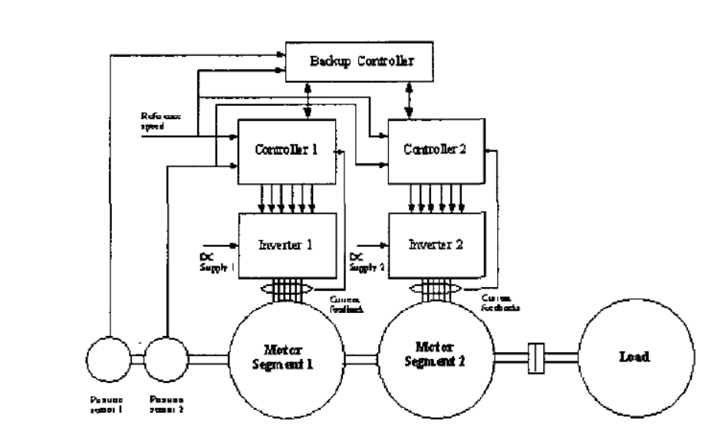
For Motor Drive System
Key terms:

Slide 23
For Motor Drive System
Key terms:
Redundancy is a mixture of series or parallel modules.

Slide 24
For Motor Drive System
Key terms:
Redundancy is a mixture of series or parallel modules.
Reliability is a measure of the time between failures occurring in a system.
by having alternative backup systems
By dividing some sections of hardware into small electrically and physically isolated units
Reliability can be increased.

Slide 25
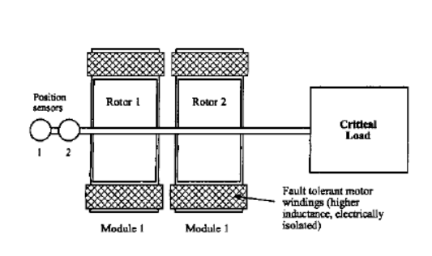
For Motor Drive System
The use of direct-drive multiple motors on the SAME shaft
Complexity & Cost increase !
Multiple segment/modular motor drive with redundancy

Slide 26
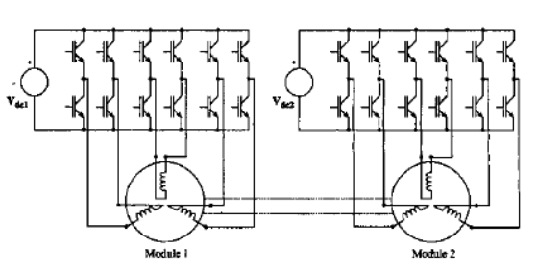
For Motor Drive System
Alternative way;
By separating the 3-phase windings and
driving each motor phase from a separate
single-phase inverter
Doubles the number of devices !
However;
Switching losses
Heat sink requirements
Less room is needed
Less weight
An alternative motor-inverter configuration

Slide 27
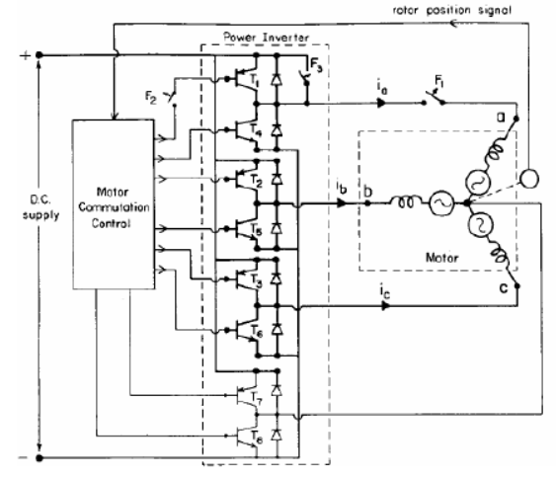
For Motor Drive System
Alternative way;
Fourth command branch in standby.

Slide 28
For Motor Drive System
Alternative way;
Fourth command branch in standby.
When the fault appears in the machine,
the standby branch becomes active
When the fault appears in the machine,
the standby branch becomes active

Slide 29
For Motor Drive System
Controlling the fault current value is important when short-circuit failure happens.
In order to limit this current,
Increase the self-inductance of the windings in design stage.

Slide 30
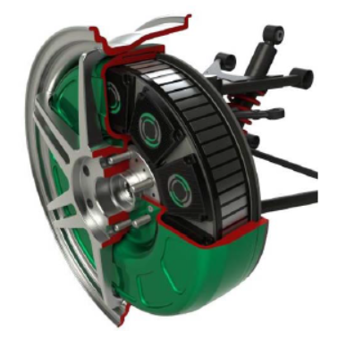
For Motor Drive System
Controlling the fault current value is important when short-circuit failure happens.
In order to limit this current,
Increase the self-inductance (per-unit) of the windings in design stage.

Slide 31
Thermal Protection
Ferrite material is used in the stator and rotor
In case of fault;

Slide 32
Thermal Protection
Ferrite material is used in the stator and rotor
In case of fault;
This material heats up due to the high fault current

Slide 33
Thermal Protection
Ferrite material is used in the stator and rotor
In case of fault;
This material heats up due to the high fault current
Becoming a nonmagnetic material

Slide 34
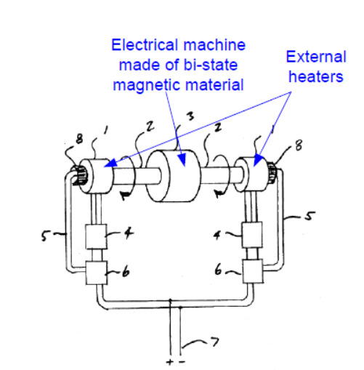
Thermal Protection
Ferrite material is used in the stator and rotor
In case of fault;
This material heats up due to the high fault current
Becoming a nonmagnetic material
External heat sources are used to speed up the heating process for cooling the ferrite.

Slide 35
Conclusion
For geometry and winding approaches,
Main idea of the solution is substituting the faulted phase’s contribution by the healthy remaining ones. And there are consequences about the dimensions and performances.

Slide 36
Conclusion
For motor drive systems,
Higher redundancy, by using identical motor segments on the same shaft
Electrically isolated phases to prevent phase to phase short-circuit and reduce inverter faults
Magnetically uncoupled windings to avoid reduction of performance in the case of a failure of the other phases
Higher winding inductance to limit the winding short-circuit current
Physically isolated phases to prevent propagation of the fault into the neighboring phases and to increase the thermal isolation
Effective cooling is important

Slide 37
References
Operation of Fault Tolerant Machines With Winding Failures, James A. Haylock, Barrie C. Mecrow, Alan G. Jack and David J. Atkinson, IEEE Transactions on Energy Conversion, Vol. 14, No. 4, December 1999
Design and Analysis of a New Fault-Tolerant Permanent-Magnet
Vernier Machine for Electric Vehicles, Guohai Liu, Junqin Yang, Wenxiang Zhao, Jinghua Ji, Qian Chen, and Wensheng Gong, IEEE TRANSACTIONS ON MAGNETICS, VOL. 48, NO. 11, NOVEMBER 2012
Fault Tolerant Electrical Machines State of the Art and Future Directions, Mircea RUBA and Loránd SZABÓ
Fault-Tolerant PM Machines: A Review Ayman M. EL-Refaie, Senior Member IEEE
Fault Tolerant and Minimum Loss Control of Double-Star Synchronous Machines Under Open Phase Conditions, Mohammad-Ali Shamsi-Nejad, Babak Nahid-Mobarakeh, Member, IEEE, Serge Pierfederici, and Farid Meibody-Tabar, IEEE TRANSACTIONS ON INDUSTRIAL ELECTRONICS, VOL. 55, NO. 5, MAY 2008

Slide 38
References
Optimal Torque Control of Fault-Tolerant Permanent Magnet Brushless Machines, Jiabin Wang, Member, IEEE, Kais Atallah, and David Howe, IEEE TRANSACTIONS ON MAGNETICS, VOL. 39, NO. 5, SEPTEMBER 2003
Fault Tolerant In-Wheel Motor Topologies for High Performance Electric Vehicles, C.J. Ifedi, B.C. Mecrow, S.T.M. Brockway, G.S. Boast, G.J. Atkinson and D. Kostic-Perovic,2011 IEEE IEMDC
Fault Tolerant Motor Drive System with Redundancy for Critical Applications N. Ertugrul, W. Soong, G. Dostal and D. Saxon
Design and Experimental Validation for Direct-Drive Fault-Tolerant Permanent-Magnet Vernier Machines, Guohai Liu, Junqin Yang,Ming Chen, and Qian Chen
Jahns, T.M., "Improved Reliability in Solid State AC Drives by Means of Multiple Independent Phase Drive Units", IEEE Transactions on Industry Applications, Vo1.16, No.3, May 1980, pp. 321-331.
Salmon J.C. and Williams B.W., A Split-Wound Induction Motor Design to Improve the Reliability of PWM Inverter Drives", IEEE Transactions on Industry Applications, Vo1.26, No.1, January/February 1980, pp.143-150.
Mecrow B.C., Jack A.G., Haylock J.A., and Coles J;"Fault Tolerant Permanent Magnet Machine Drives; IEE Proceedings, Electric Power Applications; Volume 143;Number 6; 1996,pp. 437441.
Jack A.G, Mecrow B.C., AND Haylock J.A., " A Comparative Study of Permanent Magnet and Switched Reluctance Motors for High Performance fault Tolerant Applications", IEEE, IAS Annual Meeting, 1995, pp. 734-740.

